Slide 1

CORONA VIRUS ANALYSIS
BY: Anshul Sharma

Slide 2

Table Of Contents
Project Overview
Data Description
Exploratory Data Analysis
Insights
Recommendation

Slide 3
Project Overview
CORONA VIRUS disease 2019(COVID-19) is an illness caused by a virus called severe acute respiratory syndrome. It started at the end of 2019 and became a pandemic disease in 2020. Symptoms often appear2 to 14 days after contact with the virus. These symptoms can include : dry cough, shortness of breath, loss of taste or smell, extreme tiredness, digestive symptoms, fever, etc.
The CORONA VIRUS pandemic has had a significant impact on public health and has created an urgent need for data-driven insights to understand the spread of the virus. In 2020, data was collected from over 100 countries to analyze and understand the spread of the virus. The Objective of this analysis is to discover the global impact of the virus in order to derive meaningful insights which will help aid decision making to control and manage the spread of the virus.

Slide 4
Data Description:
Province (Geographic subdivision within a country/region)
Country (Geographic entity where data is recorded)
Latitude (North-South position on Earth's surface)
Longitude (East-West position on Earth's surface)
Date (Recorded date of covid cases)
Confirmed (Number of confirmed cases of covid-19)
Deaths (Number of deaths cases of covid-19)
Recovered (Number of recovered cases of covid-19)

Slide 5
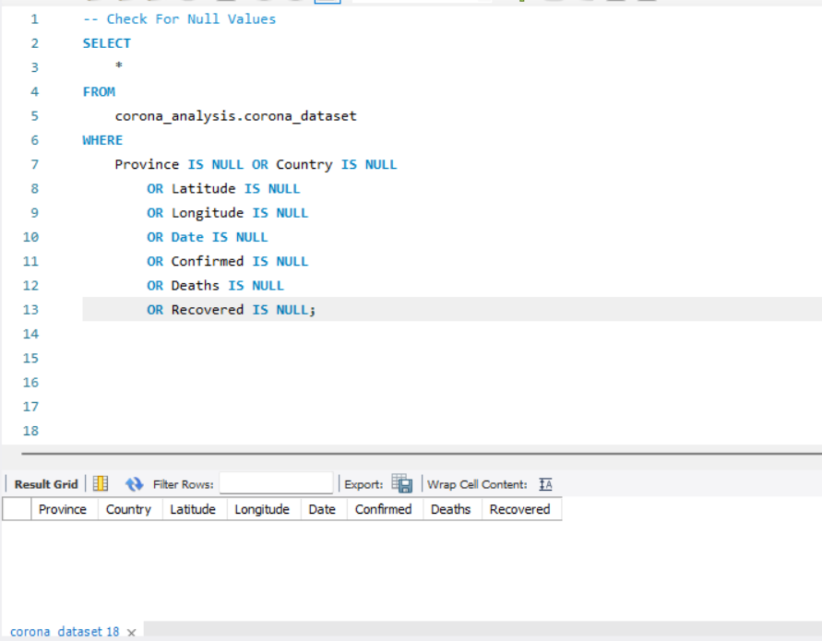
Exploratory Data Analysis
Checking for
Missing
Values
No Missing
Values (Null Values)
Found

Slide 6
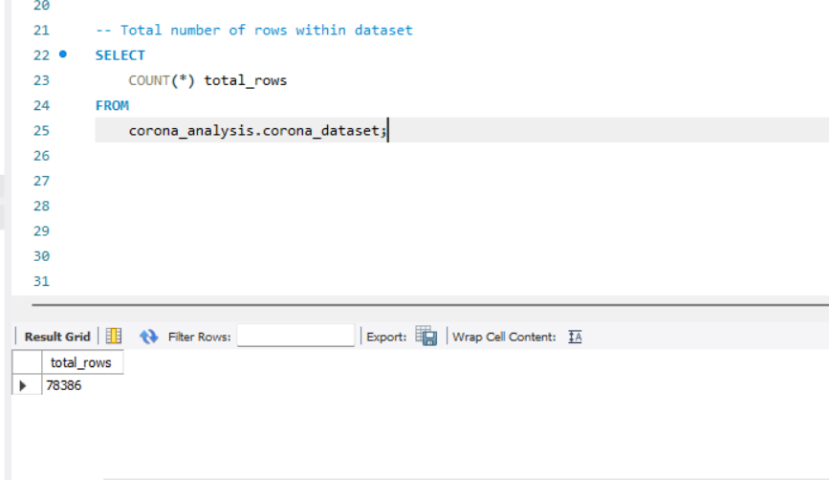
Checking Total Number of Rows

Slide 7
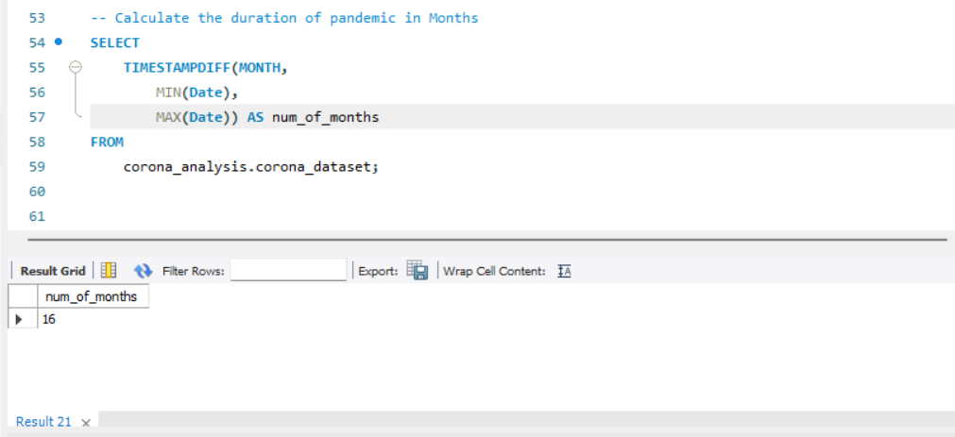
Number of months present in dataset?

Slide 8
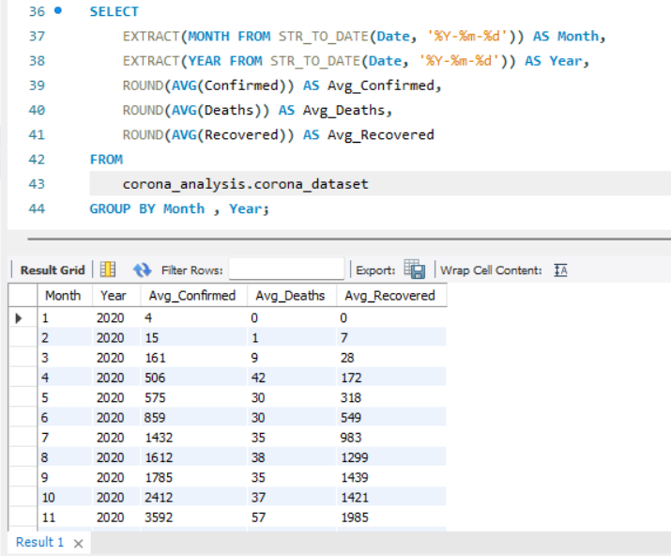
Finding monthly average for confirmed, deaths, recovered cases

Slide 9
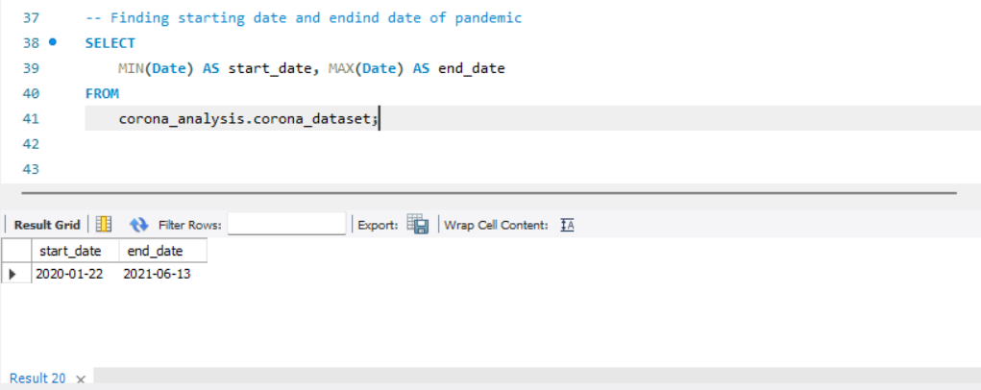
Finding Inception of virus and its end

Slide 10
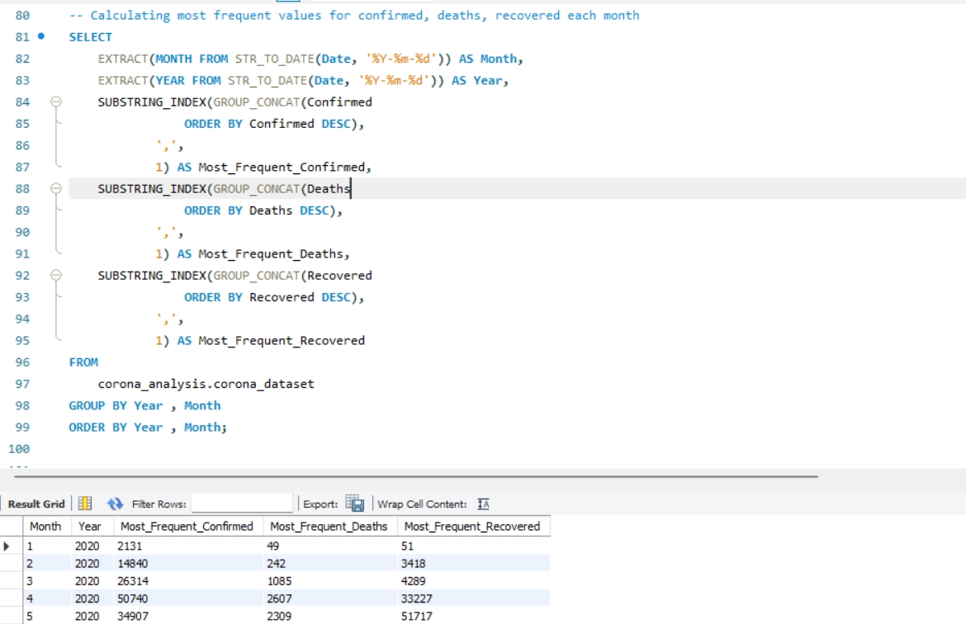
Finding most frequent value for confirmed, deaths, recovered each month

Slide 11
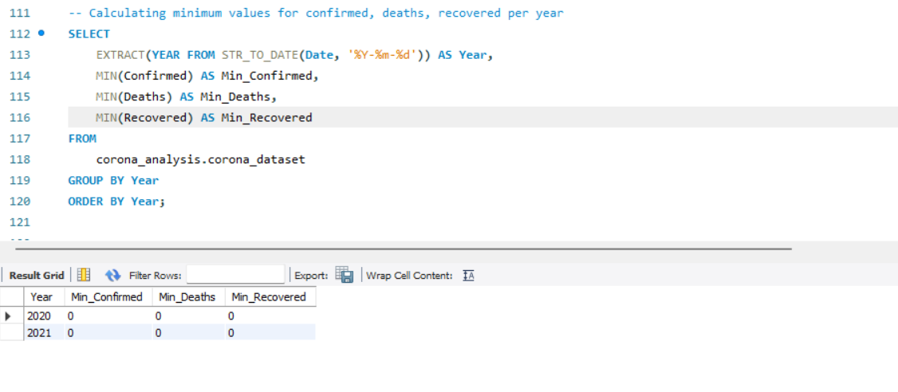
Finding minimum values for confirmed, deaths, recovered cases per year

Slide 12
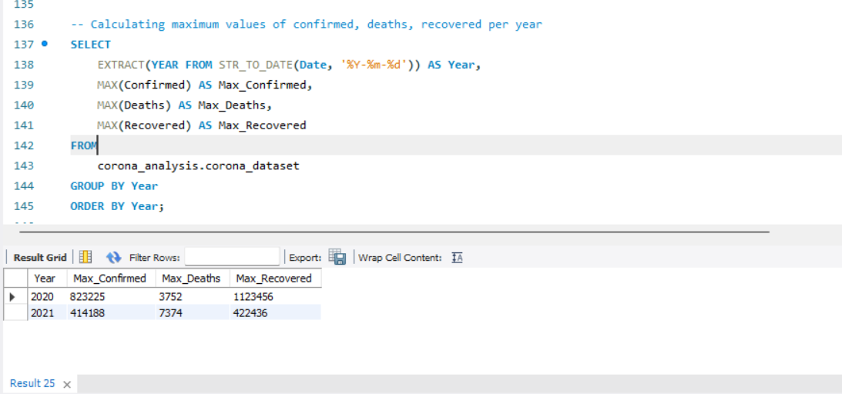
Finding maximum values for confirmed, deaths, recovered cases per year

Slide 13
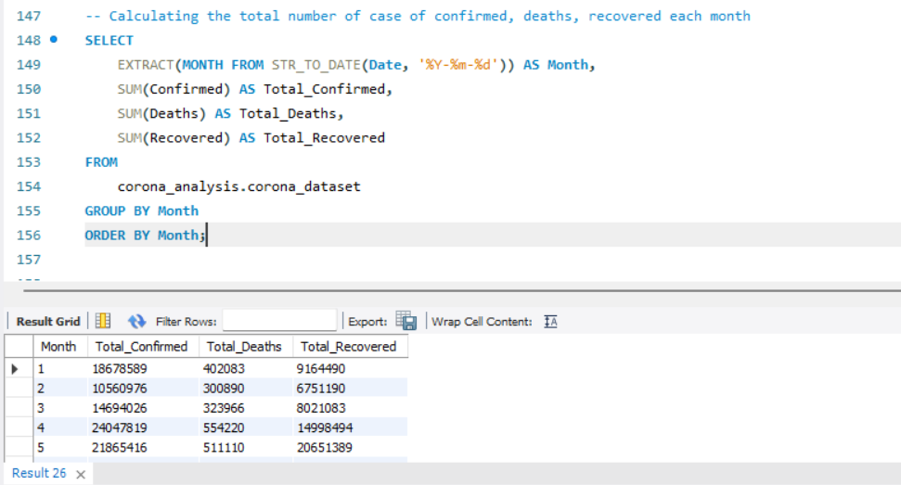
The total number of cases of confirmed, deaths, recovered each month

Slide 14
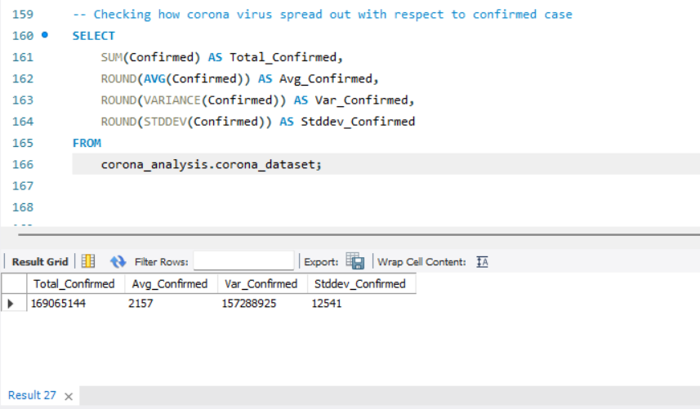
Checking how corona virus spread out with respect to confirmed cases

Slide 15
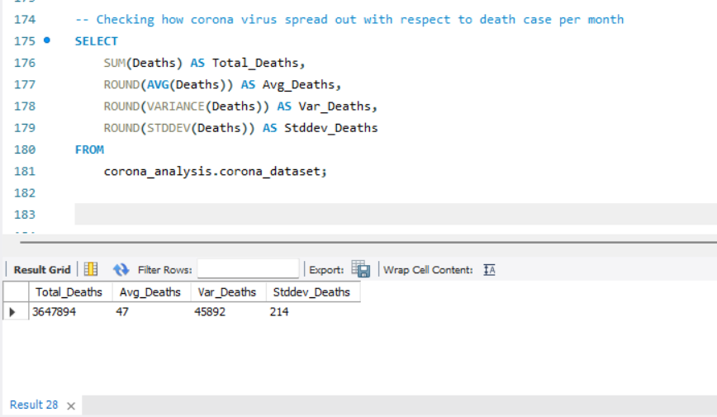
Checking how corona virus spread out with respect to death cases per month

Slide 16
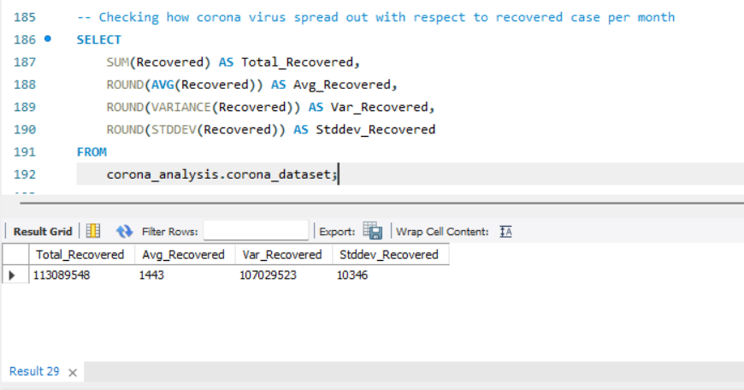
Checking how corona virus spread out with respect to recovered cases

Slide 17
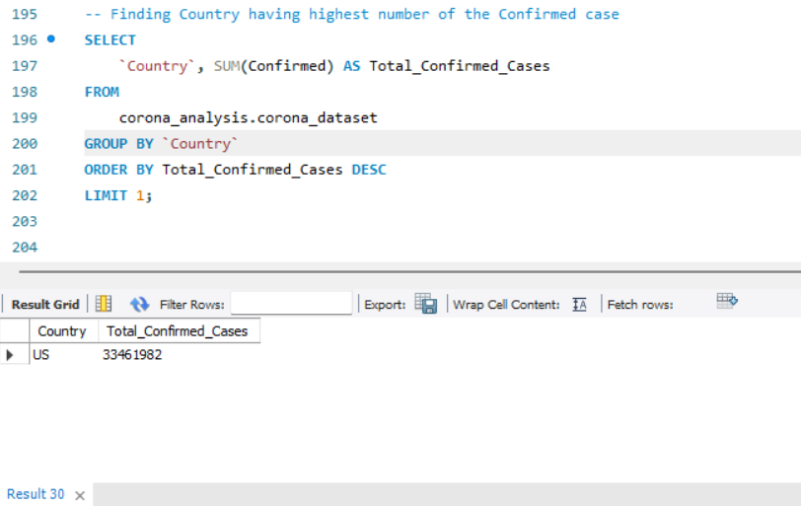
Finding countries having highest number of confirmed cases

Slide 18
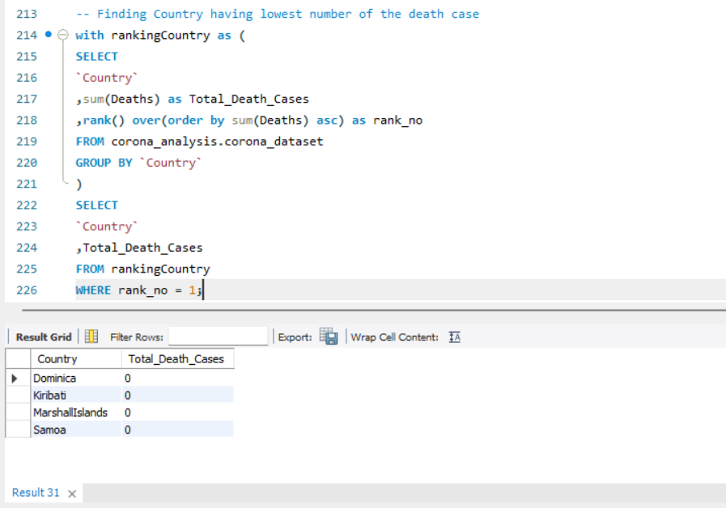
Finding countries having lowest number of death cases

Slide 19
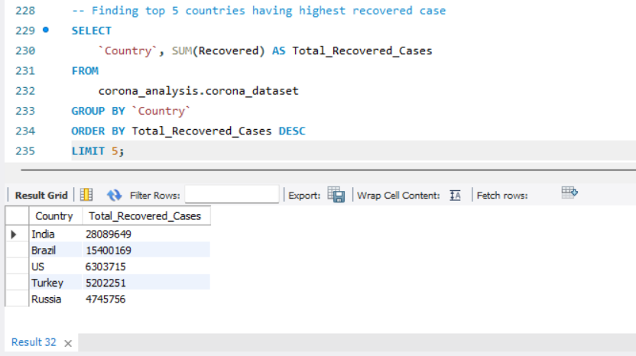
Finding top 5 countries having highest recovered cases

Slide 20
Insights
The result from the analysis indicates a high variability in the number of confirmed cases and recovered cases, which proves that the spread of the virus is uneven, with some areas or time periods experiencing higher or lower cases compared to others.
January 2020 recorded the least total death cases and least total confirmed cases of 190 and 6,384, respectively. The low variability indicates significant consistency and stability. This means the death cases and confirmed cases were relatively similar in different regions, proving a more uniform spread of the virus in terms of fatalities during the month.
However, the regions witnessed a significant increase and decrease in the spread of the virus from February 2020 to May 2021.
Marshall Islands, Samoa, Dominica, and Kiribati had the lowest count of death cases with a total of 0 respectively.

Slide 21
Recommendations
Management should promote the benefits of vaccination to minimize the spread of the virus.
Identify and focus on high - risk areas using regulations such as travel restrictions, and quarantine policies.
Incorporate the use of predictive modelling to forecast potential outbreaks and take adequate measures to prevent them.
Distribute resources such as medical equipment, health care workers, and hospital beds to areas with greater number of cases in order to control and manage the spread of the virus effectively.

Slide 22
Thank You

